Slide 1


Rockbuster Stealth
Database Analysis
Catherine Walerko

Slide 2
Project Overview
About
Key Questions
Rockbuster Stealth LLC is a movie rental company that used to have stores around the world. Facing stiff competition from streaming services such as Netflix and Amazon Prime, the Rockbuster Stealth management team is planning to use its existing movie licenses to launch an online video rental service in order to stay competitive.
Which movies contributed the most/least to revenue gain?
What was the average rental duration for all videos?
Which countries are Rockbuster customers based in?
Where are customers with a high lifetime value based?
Do sales figures vary between geographic regions?

Slide 3
Rockbuster Overview
Film
Film Count: 1000
Average Rental Duration: 5 days
Average Rental Rate: $2.98
Average Replacement Cost: $19.98
Customer
Number of Customers: 599
Number of Stores: 2

Slide 4
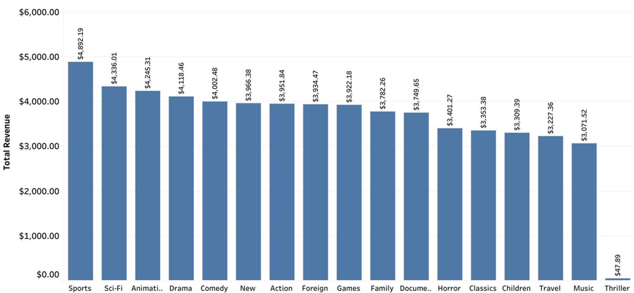
Movie Genre by Total Revenue
The top five most profitable genres are:
Sports
Sci-Fi
Animation
Drama
Comedy

Slide 5
Movies with Highest and Lowest Revenue
Top Five Movies by Revenue
Title | Genre | Revenue
Telegraph Voyage | Music | $215.75
Zorro Ark | Comedy | $199.72
Wife Turn | Documentary | $198.73
Innocent Usual | Foreign | $191.74
Hustler Party | Comedy | $190.78
Bottom Five Movies by Revenue
Title | Genre | Revenue
Texas Watch | Horror | $5.94
Oklahoma Jumanji | New | $5.94
Duffel Apocalypse | Documentary | $5.94
Freedom Cleopatra | Comedy | $5.95
Rebel Airport | Music | $6.93
Note: Only two of the Top Five movies are also in one of the Top Five movie genres (Comedy).

Slide 6
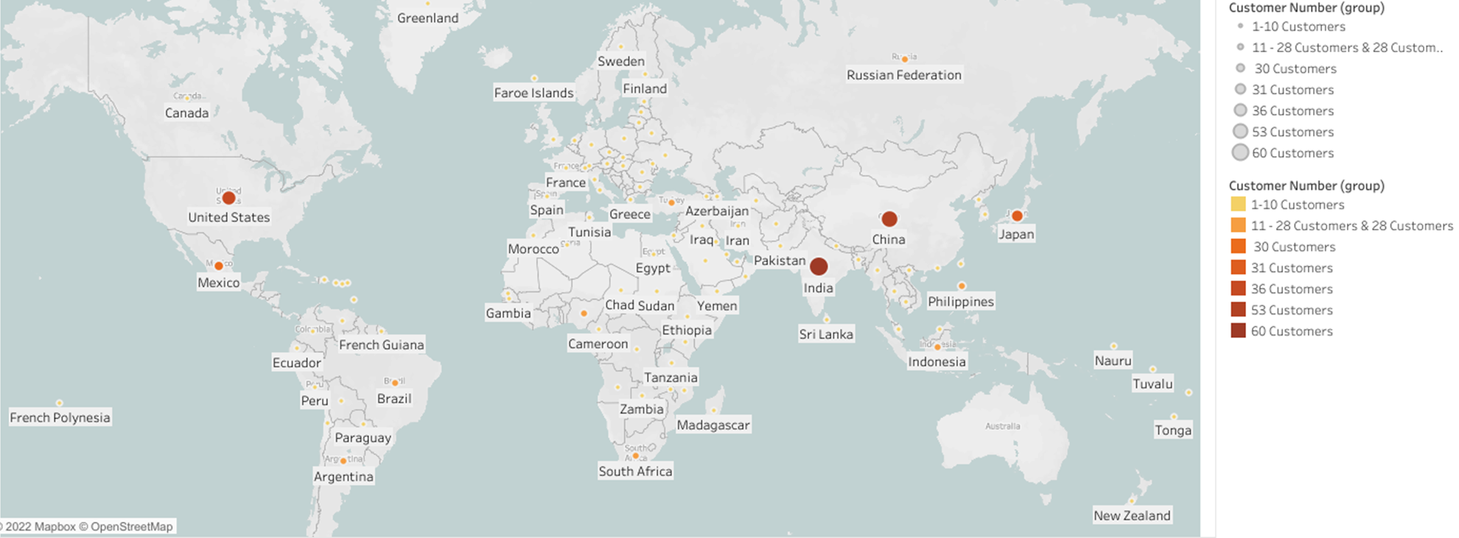
Customer Count by Country
The Top Five Countries with the highest number of customers are:
India: 60
China: 53
United States: 36
Japan: 31
Mexico: 30

Slide 7
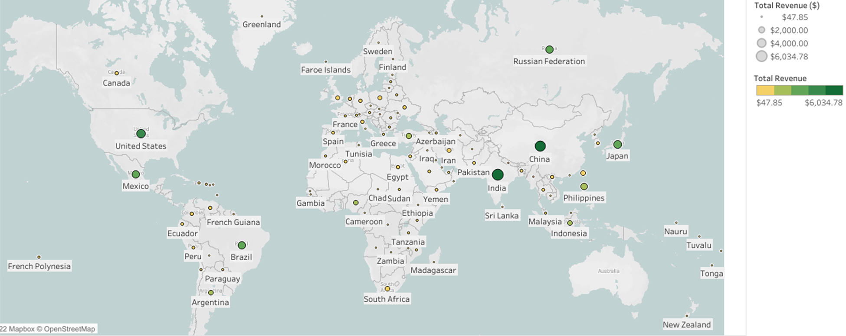
Total Revenue by Country
The Top Five countries with the highest revenue are:
India
China
United States
Japan
Mexico
Note: These are the same countries with the highest number of customers.

Slide 8
Top Five High Value Lifetime Customers
Customer ID | First Name | Last Name | Country | City | Total Amount Paid
84 | Sara | Perry | Mexico | Atlixco | $128.70
518 | Gabriel | Harder | Turkey | Sivas | $108.75
587 | Sergio | Stanfield | Mexico | Celaya | $102.76
537 | Clinton | Buford | United States | Aurora | $98.76
367 | Adam | Gooch | India | Adoni | $97.80
Note: Turkey is not one of the Top Five countries by revenue but does have the second highest value lifetime customer by total amount paid.

Slide 9
Recommendations
With only two physical stores, closing those locations should be considered. The money saved from operating expenses could go towards expanding the number of films available as well as advertising.
New films should focus on the genres of Sports, Sci-Fi, Animation, Drama, and Comedy.
It would be most advantageous to initially focus advertising efforts on the countries of India, China, Japan, the US, and Mexico before expanding.
Perks should be considered for high value lifetime customers as a reward for loyalty and to encourage retainment of new customers.

Slide 10

Questions?
Tableau Link for visualizations:
https://public.tableau.com/app/profile/catherine.walerko/viz/RockbusterStealthVisualizations/RockbusterStealthVisuals?publish=yes

